Slide 1
My Perimeter, Area and Volume Interactive Notebook
Name
Class
Term 3 Semester 2

Slide 2
Contents
Formula Page
Page
Date
Description
2
3

Slide 3
Tasks
24
7
30
Essential Question
Questions
Notes
Summary
8
9

Slide 4
24
7
30
Date
Perimeter of sectors
EQ – How does the formula for the circumference of a circle get used to find the perimeter of a sector?
9

Slide 5
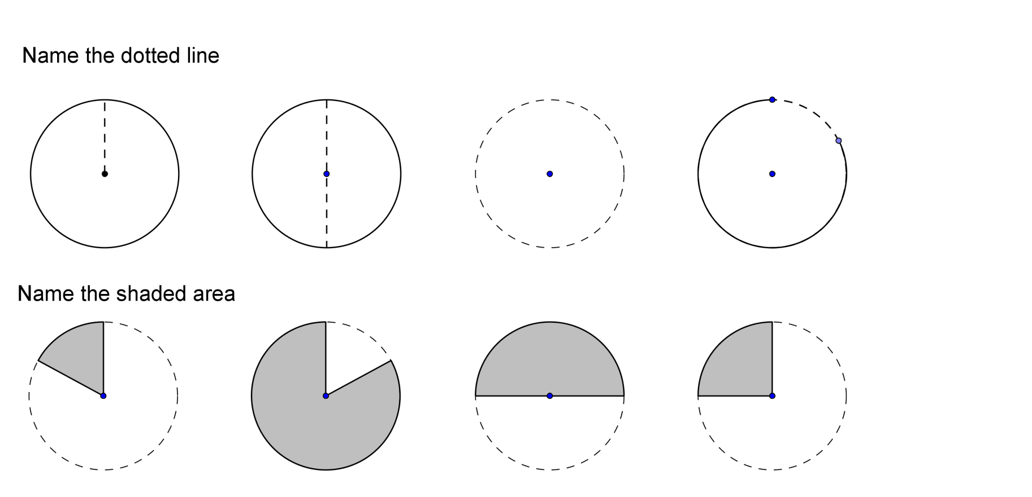

Task One
Find the circumference of the circles
Hence find the perimeter of the shapes below
30cm
6m
30m
6m

Slide 6
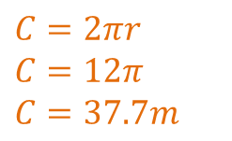
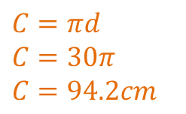
Task One
Find the circumference of the circles
Hence find the perimeter of the shapes below
$$C=πd$$
$$C=30π$$
$$C=94.2cm$$
$$C=2πr$$
$$C=12π$$
$$C=37.7m$$
30cm
6m
30m
6m

Slide 7
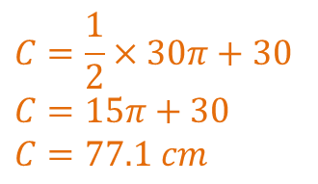
Task One
Find the circumference of the circles
Hence find the perimeter of the shapes below
$$C=πd$$
$$C=30π$$
$$C=94.2cm$$
$$C=2πr$$
$$C=12π$$
$$C=37.7m$$
30cm
6m
$$C=\frac{1}{2}×30π+30$$
$$C=15π+30$$
$$C=77.1 cm$$
30m
6m

Slide 8
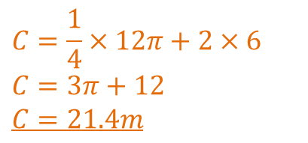
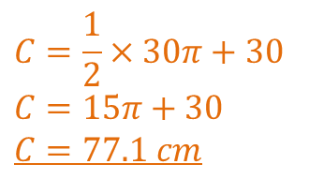
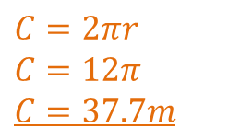
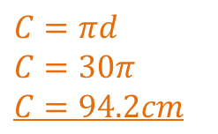
Task One
Find the circumference of the circles
Hence find the perimeter of the shapes below
$$C=πd$$
$$C=30π$$
$$C=94.2cm$$
$$C=2πr$$
$$C=12π$$
$$C=37.7m$$
30cm
6m
$$C=\frac{1}{2}×30π+30$$
$$C=15π+30$$
$$C=77.1 cm$$
$$C=\frac{1}{4}×12π+2×6$$
$$C=3π+12$$
$$C=21.4m$$
30m
6m

Slide 9
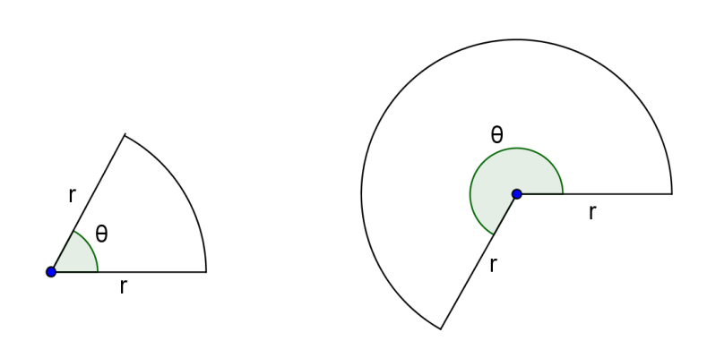
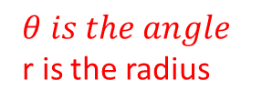
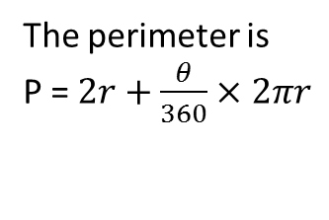
24
7
30
Date
Perimeter of sectors
EQ – How does the formula for the circumference of a circle get used to find the perimeter of a sector?
A sector is a portion of a circle
$$θ is the angle$$
r is the radius
The perimeter is
P = $2r+\frac{θ}{360}×2πr$
9

Slide 10
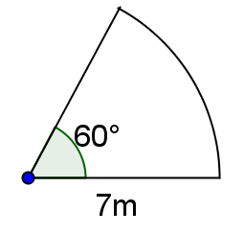
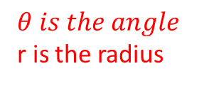
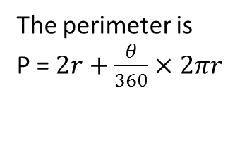
24
7
30
Date
Perimeter of sectors
EQ – How does the formula for the circumference of a circle get used to find the perimeter of a sector?
The perimeter is
P = $2r+\frac{θ}{360}×2πr$
$$θ is the angle$$
r is the radius
Find the perimeter of the shape
9

Slide 11

24
7
30
Date
Perimeter of sectors
EQ – How does the formula for the circumference of a circle get used to find the perimeter of a sector?
The perimeter is
P = $2r+\frac{θ}{360}×2πr$
$$θ is the angle$$
r is the radius
Find the perimeter of the shape
$$θ=60° and r=7$$
9

Slide 12
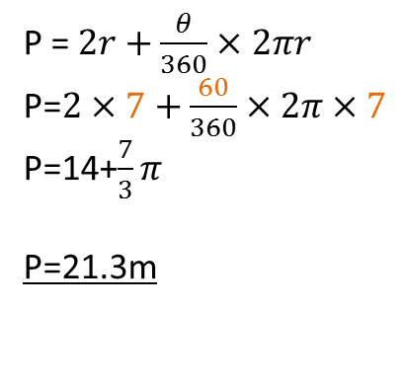
24
7
30
Date
Perimeter of sectors
EQ – How does the formula for the circumference of a circle get used to find the perimeter of a sector?
The perimeter is
P = $2r+\frac{θ}{360}×2πr$
$$θ is the angle$$
r is the radius
Find the perimeter of the shape
$$θ=60° and r=7$$
P = $2r+\frac{θ}{360}×2πr$
P=$2×7+\frac{60}{360}×2π×7$
P=14+$\frac{7}{3}π$
P=21.3m
Exact answer
Rounded answer
9

Slide 13
Fill in the questions
Complete the worksheet

Slide 14
24
7
30
Date
Perimeter of sectors
EQ – How does the formula for the circumference of a circle get used to find the perimeter of a sector?
What is a sector?
A sector is a portion of a circle
$$θ is the angle$$
r is the radius
How do I find the perimeter of a sector?
The perimeter is
P = $2r+\frac{θ}{360}×2πr$
Example
9

Slide 15
Notes Review
24, 7 ,30
Date
Title
Essential question
Notes complete
Notes complete with colour and diagrams
Questions completed
Contents page filed in
Formula page filled in

Slide 16
Homework
Review your notes and write a summary answering the essential question.

